Slide 1
ENGINEERING ECONOMY
LECTURE 4
PROF.DR. YASEMİN ASU ÇIRPICI, MU, DEPT. OF ECONOMICS

Slide 2
Calculations Involving Uniform Series and Randomly Placed Single Amounts
When a cash flow includes both a uniform series and randomly placed single amounts, the procedures of previous lectures are applied to the uniform series and the single-amount formulas are applied to the one-time cash flows.

Slide 3
EXAMPLE
An engineering company in Wyoming that owns 50 hectares of valuable land has decided to lease the mineral rights to a mining company. The primary objective is to obtain long-term income to finance ongoing projects 6 and 16 years from the present time. The engineering company makes a proposal to the mining company that it pay $20,000 per year for 20 years beginning 1 year from now, plus $10,000 six years from now and $15,000 sixteen years from now. If the mining company wants to pay off its lease immediately, how much should it pay now if the investment is to make 16% per year?

Slide 4
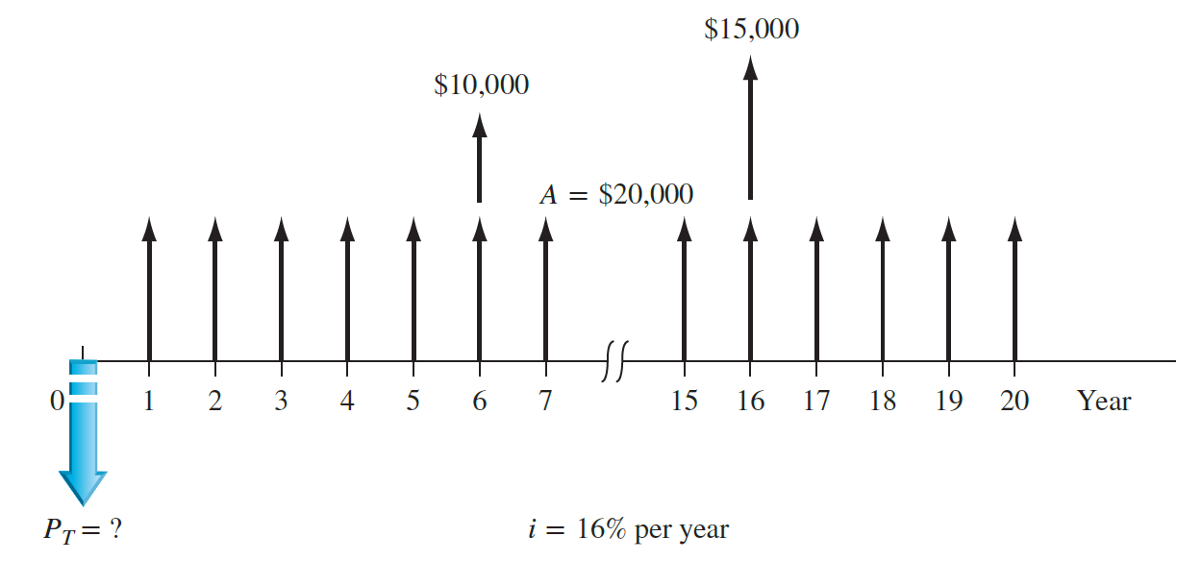
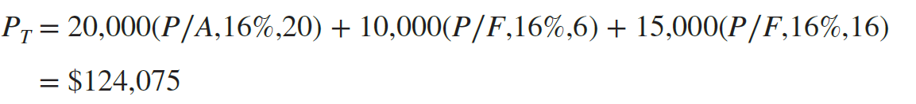
Find the present worth of the 20-year uniform series and add it to the present worth of the two one-time amounts to determine P_{T}'.

Slide 5
When you calculate the A value for a cash flow series that includes randomly placed single amounts and uniform series, first convert everything to a present worth or a future worth.
Then you obtain the A value by multiplying P or F by the appropriate A∕P or A∕F factor.
A value by multiplying P or F by the appropriate A∕P or A∕F factor.

Slide 6
EXAMPLE:
A design-build-operate engineering company in Texas that owns a sizable amount of land plans to lease the drilling rights (oil and gas only) to a mining and exploration company. The contract calls for the mining company to pay $20,000 per year for 20 years beginning 3 years from now (i.e., beginning at the end of year 3 and continuing through year 22) plus $10,000 six years from now and $15,000 sixteen years from now. Utilize engineering economy relations to determine the five equivalent values listed below at 16% per year.
1. Total present worth P_{T} in year 0
2. Future worth F in year 22
3. Annual series over all 22 years
4. Annual series over the first 10 years
5. Annual series over the last 12 years

Slide 7
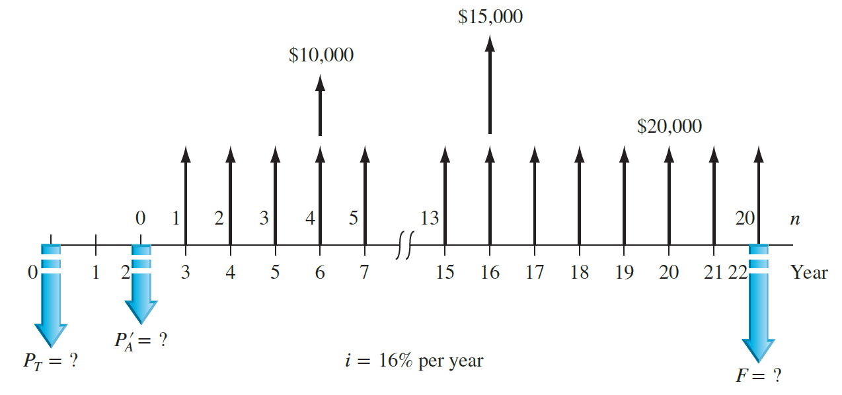
1. P_{T} in year 0: First determine P'_{A} of the series in year 2. Then P_{T} is the sum of three P values: the series present worth value moved back to t = 0 with the P∕F factor, and the two P values at t = 0 for the two single amounts in years 6 and 16.

Slide 8
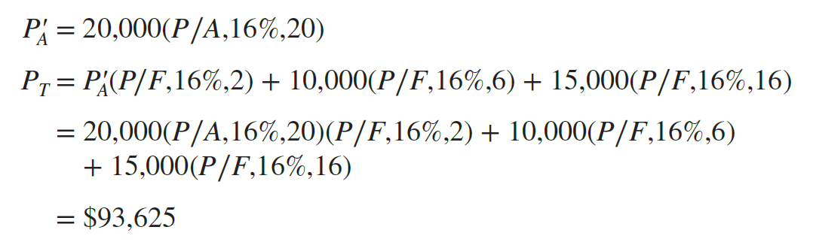
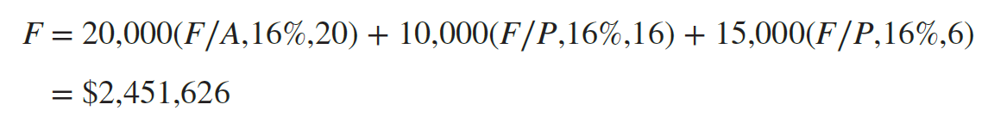
2. F in year 22: To determine F in year 22 from the original cash flows, find F for the 20-year series and add the two F values for the two single amounts. Be sure to carefully determine the n values for the single amounts: n = 22 − 6 = 16 for the $10,000 amount and n = 22 − 16 = 6 for the $15,000 amount.

Slide 9
3. A over 22 years: Multiply P_{T} = $93,625 by the A∕P factor to determine an equivalent 22-year A series, referred to as A_{1–22} here.
OR

Slide 10
4. A over years 1 to 10: The equivalent A series is calculated for a number of years different from that covered by the original cash flows.
This occurs when a defined study period or planning horizon is preset for the analysis.
To determine the equivalent A series for years 1 through 10 only (call it A_{1–10}), the P_{T} value must be used with the A∕P factor for n = 10.
5. A over years 11 to 22: For the equivalent 12-year series for years 11 through 22 (call it A_{11–22}), the F value must be used with the A∕F factor for 12 years.

Slide 11
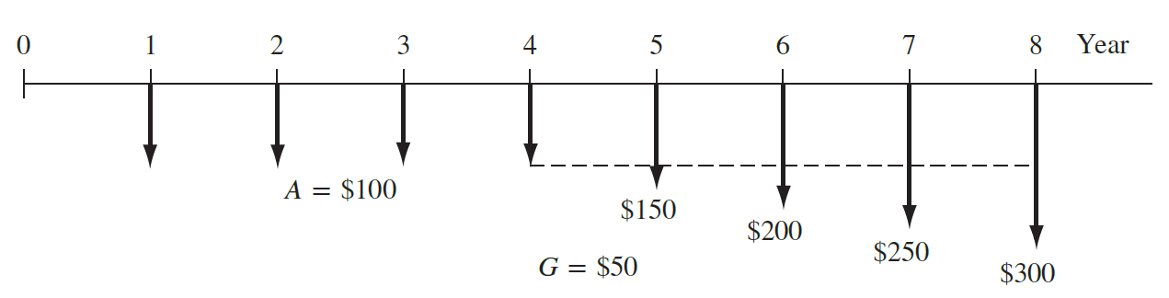
EXAMPLE
Fujitsu, Inc. has tracked the average inspection cost on a robotics manufacturing line for 8 years. Cost averages were steady at $100 per completed unit for the first 4 years, but have increased consistently by $50 per unit for each of the last 4 years.
Analyze the gradient increase, using the P∕G factor. Where is the present worth located for the gradient?
What is the general relation used to calculate total present worth in year 0?

Slide 12
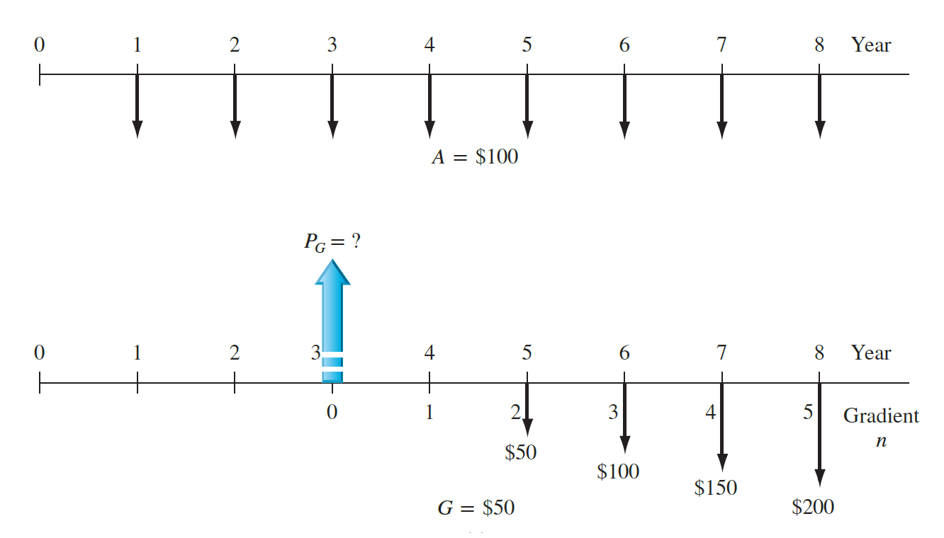
The cash flow diagram shows the base amount A = $100 and the arithmetic gradient G = $50 starting between periods 4 and 5.
Figure below partitions these two series. Gradient year 2 is placed in actual year 5 of the entire sequence. It is clear that n = 5 for the P∕G factor. The P_{G} = ? arrow is correctly placed in gradient year 0, which is year 3 in the cash flow series.

Slide 13
The uniform series A = $100 occurs for all 8 years, and the G = $50 gradient present worth PG appears in year 3.

Slide 14
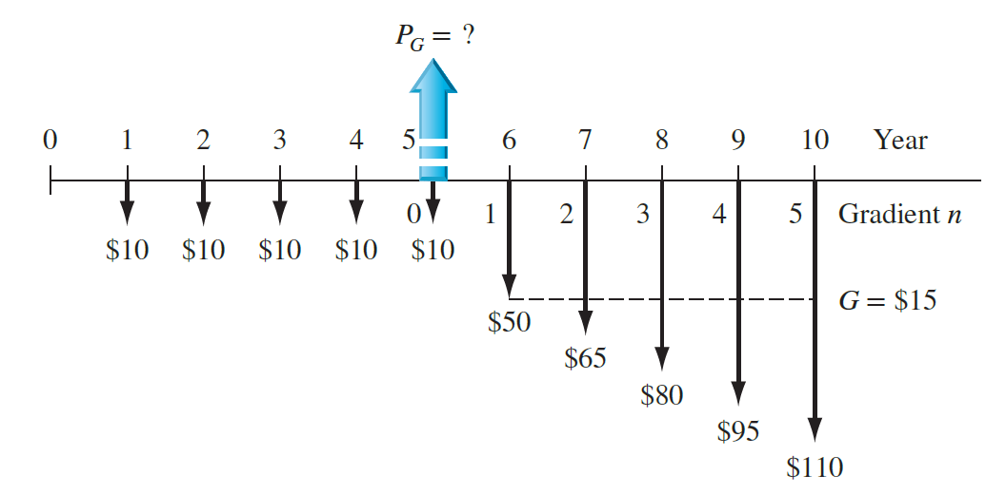
To find the equivalent annual series in years 1 through 10 for the gradient series only, first find the present worth PG of the gradient in actual year 5, take this present worth back to year 0, and annualize the present worth for 10 years with the A∕P factor. If you apply the annual series gradient factor (A∕G,i,5) directly, the gradient is converted into an equivalent annual series over years 6 through 10 only, not years 1 through 10, as requested.

Slide 15
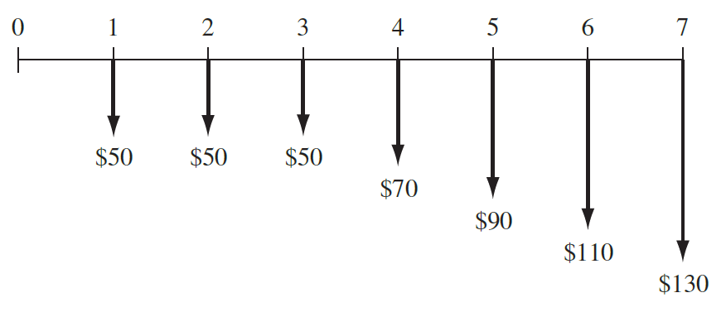
EXAMPLE
Set up the engineering economy relations to compute the equivalent annual series in years 1 through 7 for the cash flow estimates in Figure below

Slide 16
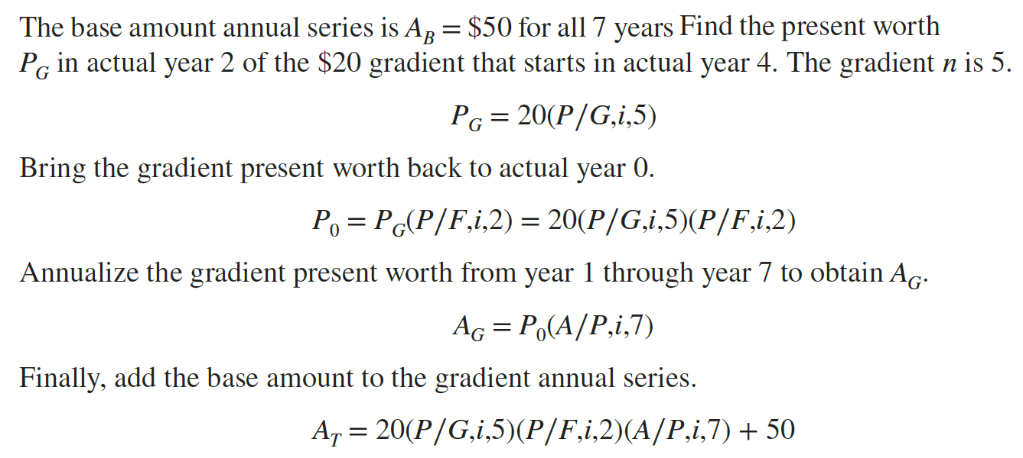

Slide 17
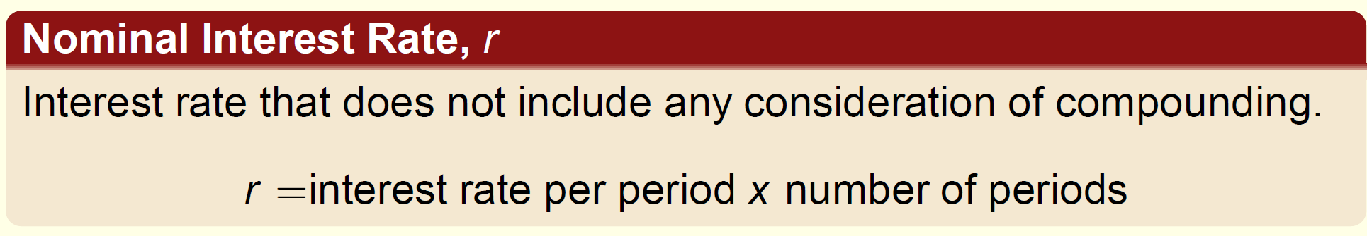
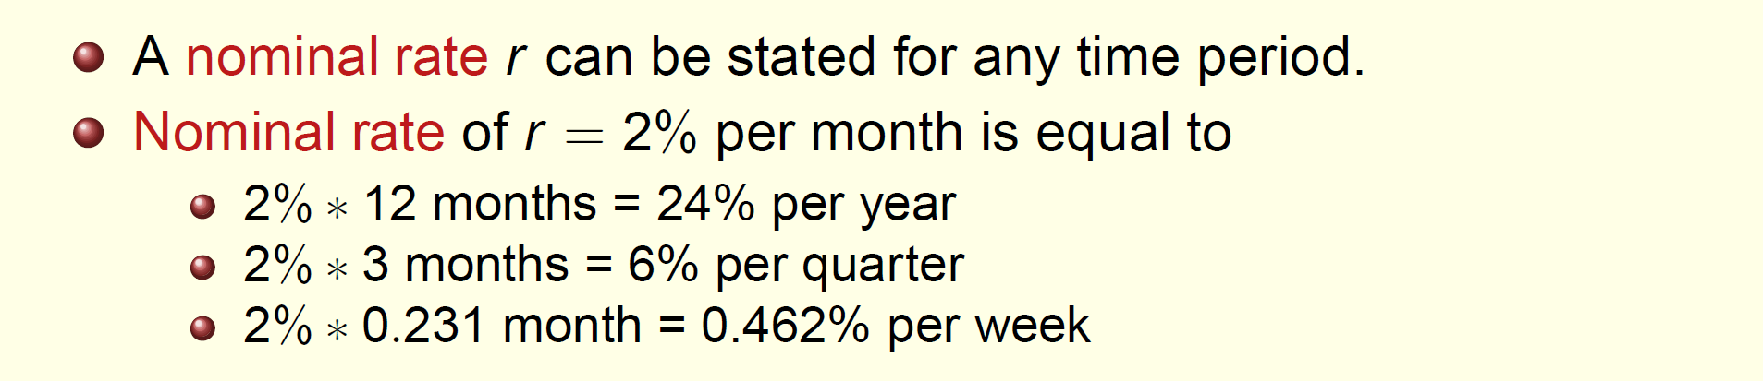
Nominal and Effective Interest Rates

Slide 18
Effective interest rate is the actual rate that applies for a stated period of time. (The actual amount of interest that will accumulate in a stated period of time.)
The compounding of interest during the time period of the corresponding nominal rate is accounted for by the effective interest rate.
Effective interest rate is commonly expressed on an annual basis as the effective rate, i_{a}, but any time basis can be used.
Effective rate has the compounding frequency attached to the nominal rate statement (4% per year, compounded monthly)
If compounding frequency is not stated, it is assumed to be the same as the time period of r , i.e. compounding 1 time during the time period
All the interest formulas, factors, tabulated values must have the effective interest rate to properly account for the time value of money.
Therefore, we should know how to calculate the effective interest rate value for any nominal or effective rate statement.

Slide 19
Annual Percentage Rate (APR) and Annual Percentage Yield (APY) can be used as instead of nominal and effective interest rates in practice.
There are always three time-based units associated with an interest rate statement.
Time Period- The period over which the interest is expressed. It is the t in the statement of r% per time period t (1% per month)
Compounding Period- the shortest time period over which interest is charged or earned. (8% per year compounded monthly, therefore CP is month)
Compounding frequency- the number of times that m compounding occurs within the time period t. If the compounding period (CP) and the time period t are the same, the compounding frequency is 1 (1% per month compounded monthly.)

Slide 20
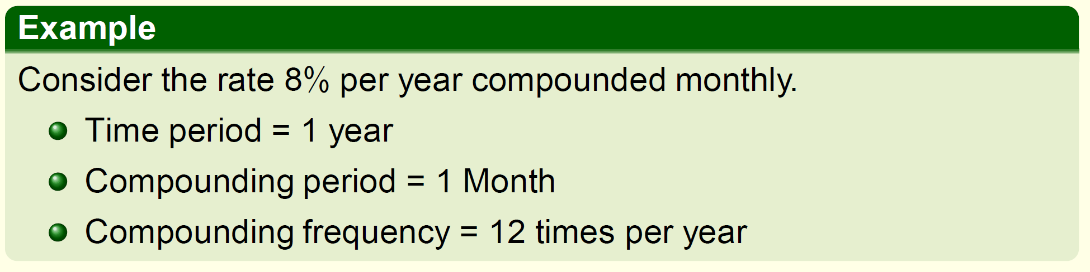
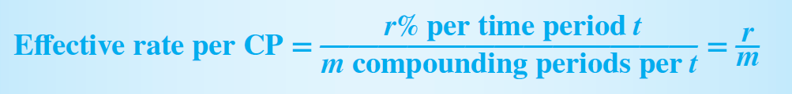
So far all the interest rates used have t and m as 1 year (8% per year). The effective and nominal rates were the same. It is common practice to express the rates on the same time basis as the compounding period.

Slide 21
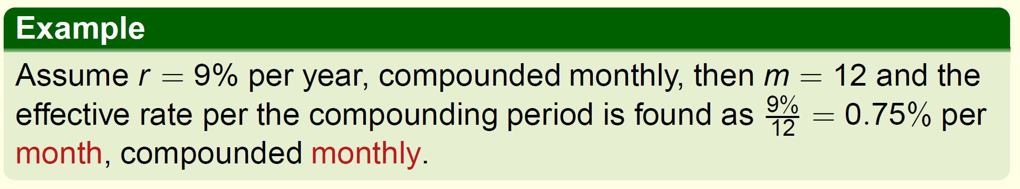
NOTE: Changing the basic time period t does not alter the compounding period, month in the previous example.
Whenever time period = compounding period, stated nominal rate is an effective rate. Therefore, i_{cp} is the effective rate per CP too.

Slide 22
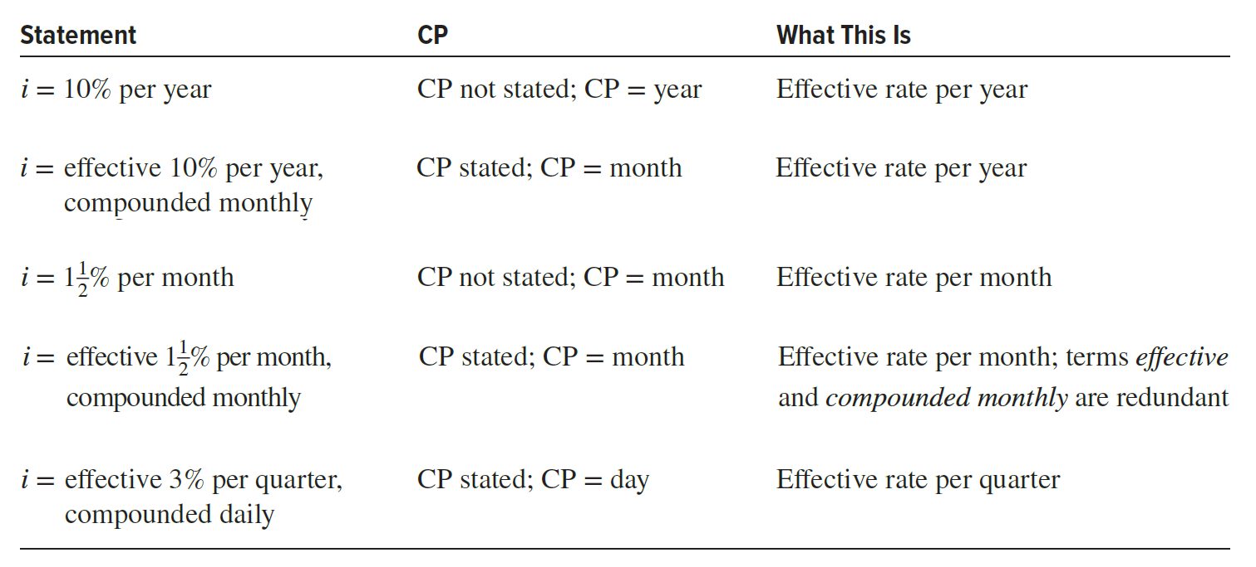

Slide 23
EXAMPLE
Three different bank loan rates for electric generation equipment are listed below. Determine the effective rate on the basis of the compounding period for each rate.
(a) 9% per year, compounded quarterly.
(b) 9% per year, compounded monthly.
(c) 4.5% per 6 months, compounded weekly.

Slide 24
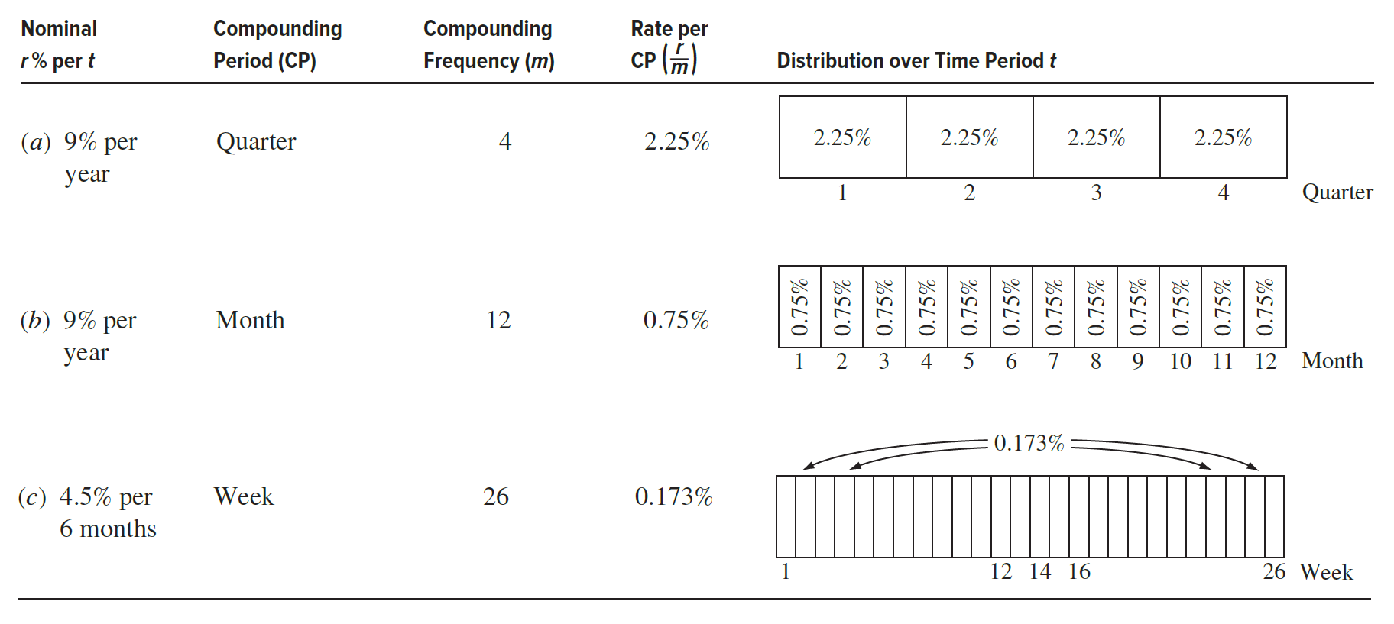

Slide 25
The Credit Card Offer Case:
Today, Dave received a special offer of a new credit card from Chase Bank linked with the majör airline that he flies frequently.
It offers a generous bonus package for signing up by a specific date about 60 days from now.
The bonus package includes extra airline points (once the first purchase is made), priority airport check-in services (for 1 year), several free checked-bag allowances (for up to 10 check-ins), extra frequent-flyer points on the airline, Access to airline lounges (provided he uses the card on a set time basis), plus several other rewards (rental car discounts, cruise trip amenities, and floral order discounts).

Slide 26
The annual fee of $85 for membership does not start until the second year, and balance transfers from other credit cards have a low transfer fee, provided they are made at the time of initial membership.
Dave has a credit card currently with a bank that he is planning to leave due to its poor customer service and high monthly fees.
If he enrolls, he will transfer the $1000 balance on the current card to the new Chase Bank card. I
n the page that accompanies the offer letter, “pricing information” is included. This includes interest rates, interest charges, and fees. A summary of several of these rates and fees follows.

Slide 27
APR (annual percentage rate) for purchases and balance transfers
APR for cash and overdraft advances
Penalty APR for late minimum payment, exceeding credit limit, and returned unpaid payments
14.24% per year (sum of the current U.S. Government prime rate of 3.25% and 10.99%, which is the APR added to determine the balance transfer APR for Chase Bank)
19.24% per year
29.99% per year (maximum penalty APR)

Slide 28
Fees are listed as follows:
Annual membership
Balance transfers
Cash advances
Late payment
Over the credit limit
Returned check or payment
$85; free the first year
$5 or 3% of each transfer, whichever is greater
$10 or 3% of each advance, whichever is greater
$39 each occurrence, if balance exceeds $250
$39 each occurrence
$39 each occurrence
All APR rates are variable, based on a current 3.25% prime rate with 10.99% added to determine purchase∕balance transfer APR; with 15.99% added to determine cash∕overdraft APR; and with 26.99% added to determine penalty APR. †The penalty APR applies indefinitely to future transactions. If no minimum payment is received within 60 days, the penalty APR applies to all outstanding balances and all future transactions on the account.

Slide 29
The balance transfer APR interest rate of 14.24% is an annual rate, with no compounding period mentioned. Therefore, we should conclude that the CP is 1 year, the same as the annual interest period of the APR. However, as Dave and we all know, credit card payments are required monthly.
(a) Determine the effective interest rates for compounding periods of 1 year and 1 month so Dave knows some effective rates he might be paying when he transfers the $1000 balance from his current card.
(b) Assume that immediately after he accepts the card and completes the $1000 transfer, Dave gets a bill that is due 1 month later. What is the amount of the total balance he owes?
Now, Dave looks a little closer at the fine print of the “pricing information” sheet and discovers a small-print statement that Chase Bank uses the daily balance method (including new transactions) to determine the balance used to calculate the interest due at payment time.
(c) We will reserve the implication of this new finding until later, but for now help Dave by determining the effective daily interest rate that may be used to calculate interest due at the end of 1 month, provided the CP is 1 day.

Slide 30
(a) The interest period is 1 year
CP of year: Effective rate per year = 14.24∕1 = 14.24%
CP of month: Effective rate per month = 14.24∕12 = 1.187%
(b) The interest will be at the monthly effective rate, plus the balance transfer fee of 3%.
Amount owed after 1 month = 1000 + 1000(0.01187) + 0.03(1000)
= 1000 + 11.87 + 30
= $1041.87
Including the $30 fee, this represents an interest rate of (41.87∕1000)(100%) = 4.187% for only the 1-month period.
(c) now m = 365 compounding periods per year.
CP of day: Effective rate per day = 14.24∕365 = 0.039%

Slide 31
For the Effective Annual Interest rate, time period t is year, and the compounding period can be any time unit less than a year.
Effective interest rate at any point during the year includes the interest rate of all previous compounding periods during the year.
Derivation of the effective annual interest rate formula directly parallels the logic of the future worth relation F = P(1 + i)n.
Rewrite the formula as F = P(1 + i_{a}), since interest can be compounded many times a year.
The rate i_{cp} per CP must be compounded through all m years to find the total effect of compounding by the end of year.

Slide 32
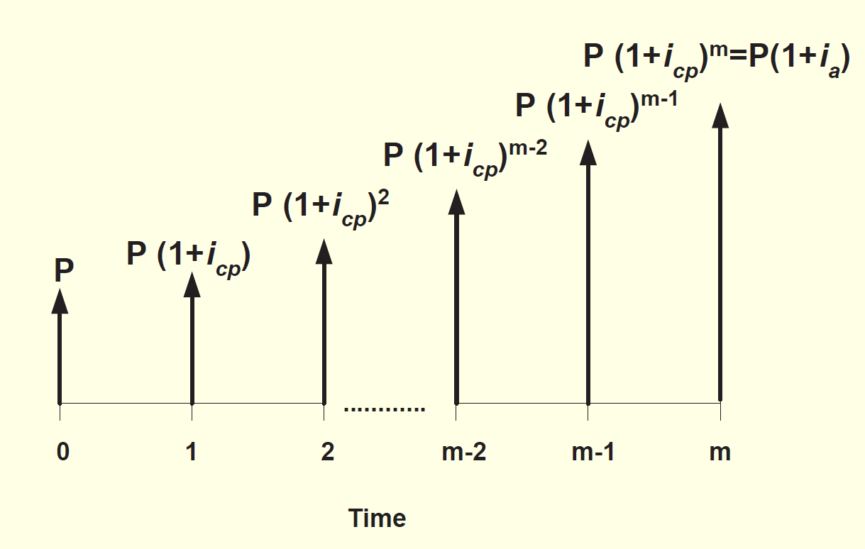
r : nominal interest rate per year
m: compounding occurs within the time period t (1 year).
i_{cp}: effective interest rate per compounding period (r/m)
i_{a}: effective interest rate per year

Slide 33
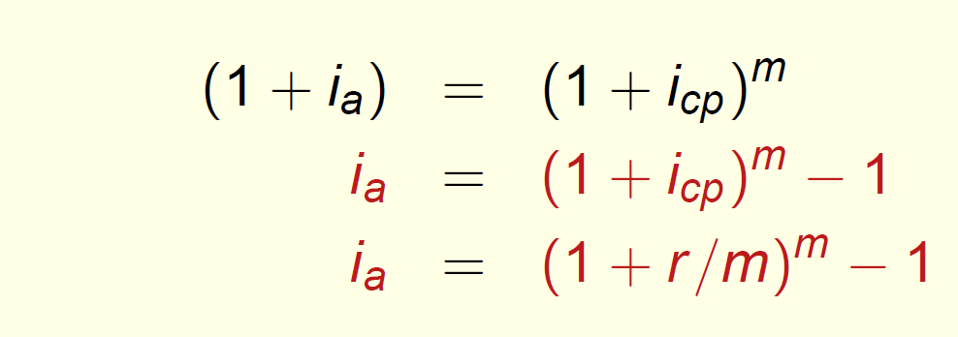

Slide 34
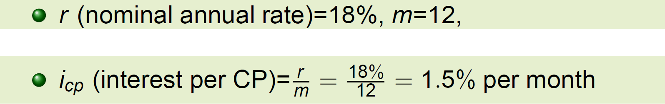
EXAMPLE
Kelso obtained a new credit card from a national bank, MBNA, with a stated rate of 18% per year, compounded monthly. For a $1,000 balance at the beginning of the year, find the effective annual rate and the total amount owed to MBNA after 1 year, provided no payments are made during the year.

Slide 35
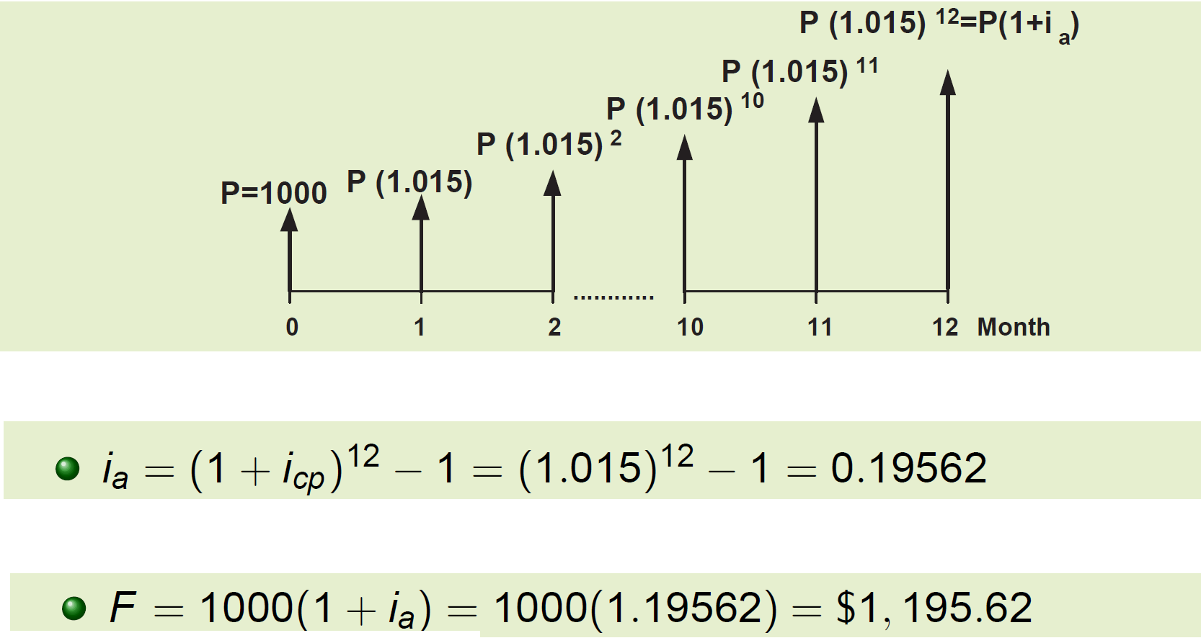

Slide 36
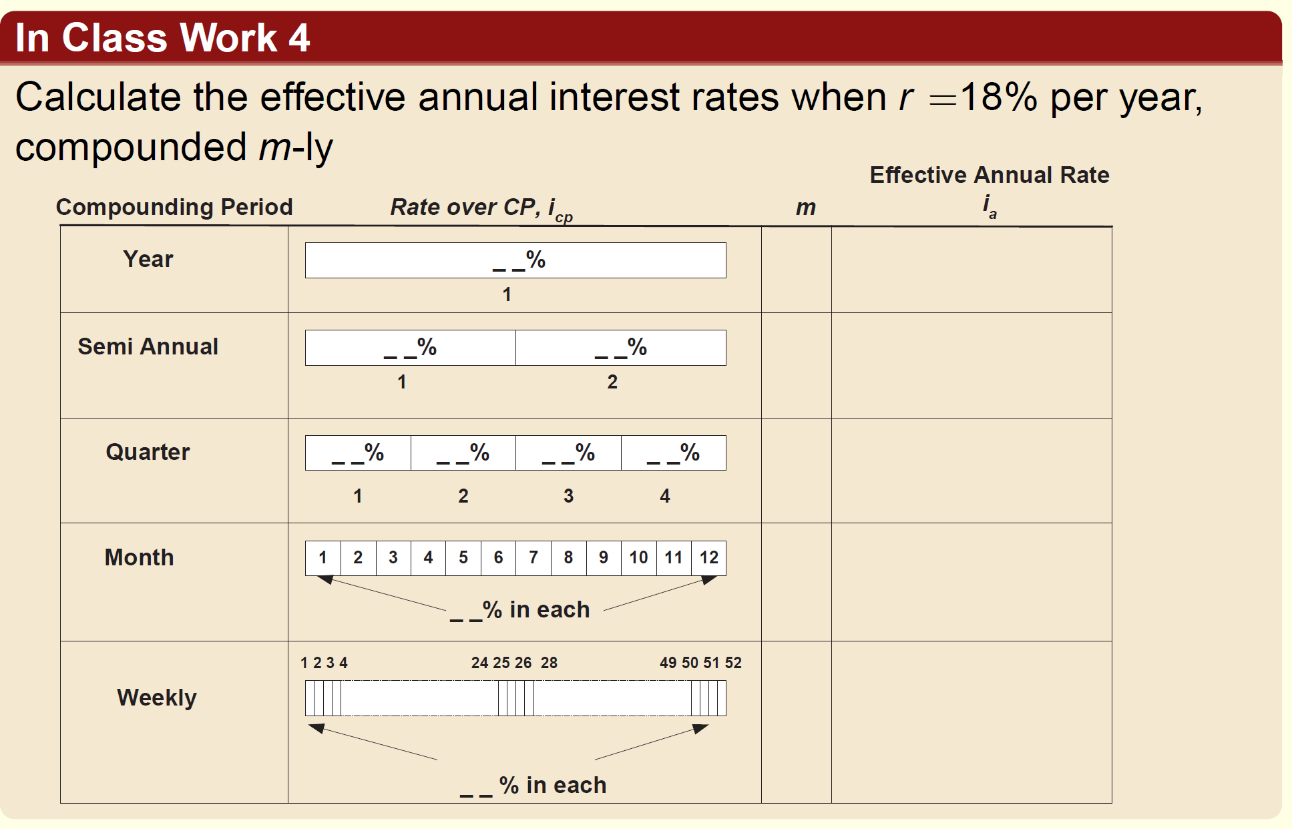

Slide 37
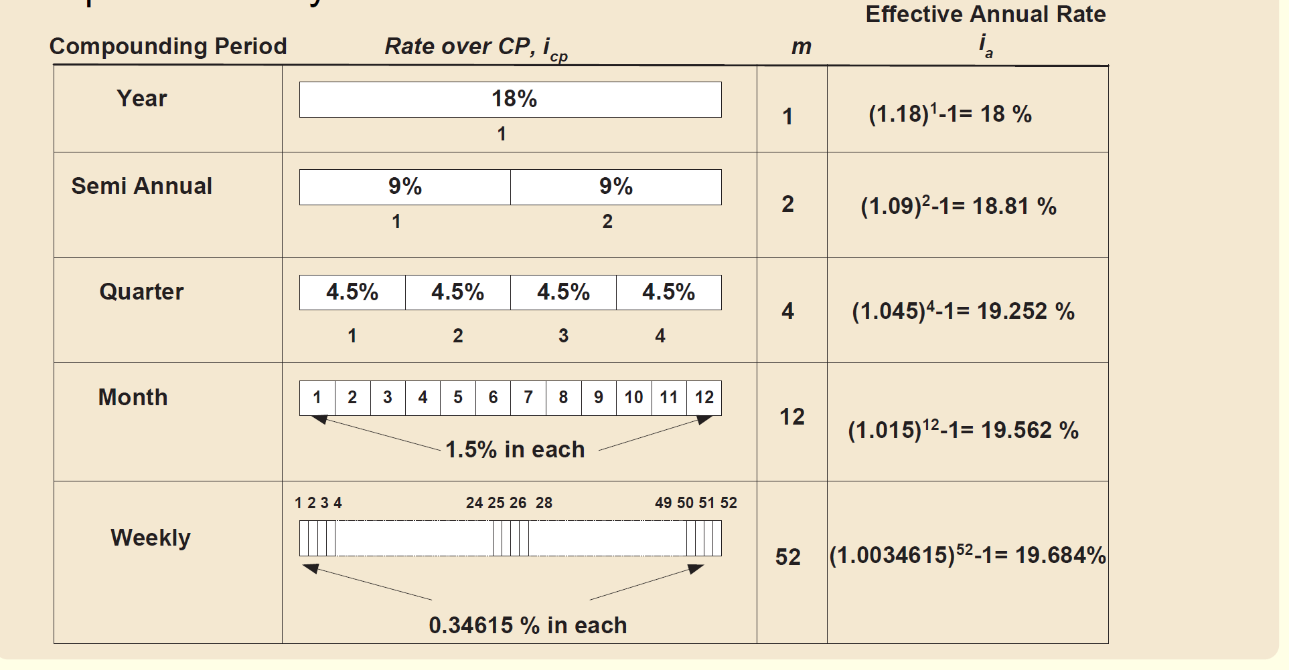

Slide 38
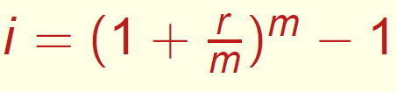
Now, we need to introduce the payment period, the frequency of payments or receipts. Most of the time the compounding period and payment period are not the same.
A company deposits money into an account each month that pays a nominal interest rate of 12% per year, compounded semiannually.
Compounding period = 6 months
Payment period = 1 month
To evaluate cash flows occurring more frequently than annually, effective interest rate over the payment period must be calculated.
Let r : nominal interest rate per payment period
Let m: number of compounding periods per payment period
Effective interest:

Slide 39
Meaning of the Effective Interest Rate (EIR)
The Effective Interest Rate (EIR) — sometimes called the Effective Annual Rate (EAR) — tells you the true annual return or cost of money after accounting for compounding.
In other words:
It shows how much your money actually grows (or how much you really pay) in one year, given that interest is added to the principal more than once a year.

Slide 40
Why do we need it?
Banks, loans, and investments often quote a nominal rate (r) — like 12% per year, compounded monthly.
That means interest is applied 12 times a year, not just once.
However, because interest earns more interest each period (compounding), the actual annual return is higher than 12%.
So the effective rate (i) translates that compounding effect into a single, once-per-year rate — the true equivalent.

Slide 41
Imagine two investments:
Investment | Quoted rate | Compounding | Actual gain after 1 year
A | 12% per year (annual) | Once per year | 12.00%
B | 12% per year (monthly) | 12 times per year | 12.68%
Both sound like 12%,
but B actually gives you more money because it compounds interest every month.

Slide 42
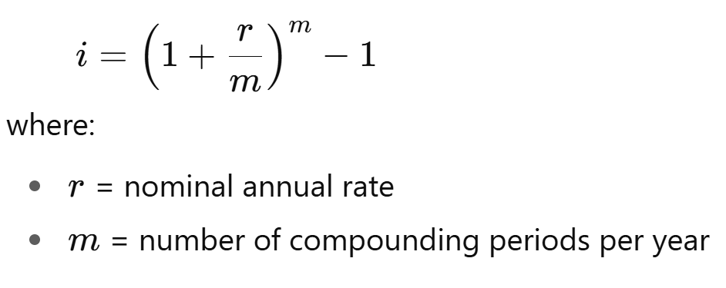
EXAMPLE
A bank offers a nominal annual interest rate of
r=12% per year, compounded monthly.
Find the effective annual interest rate i.

Slide 43
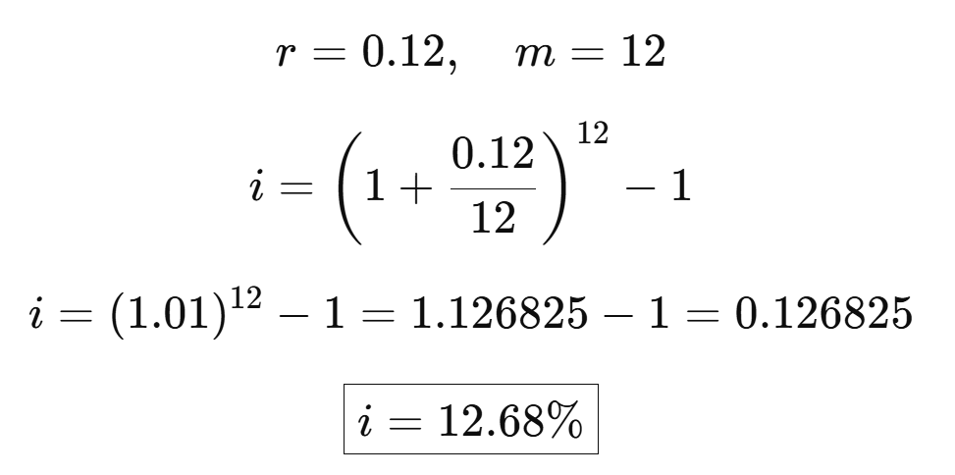
Although the nominal rate r is 12%, the effective annual rate i is 12.68%, because interest is compounded monthly.

Slide 44
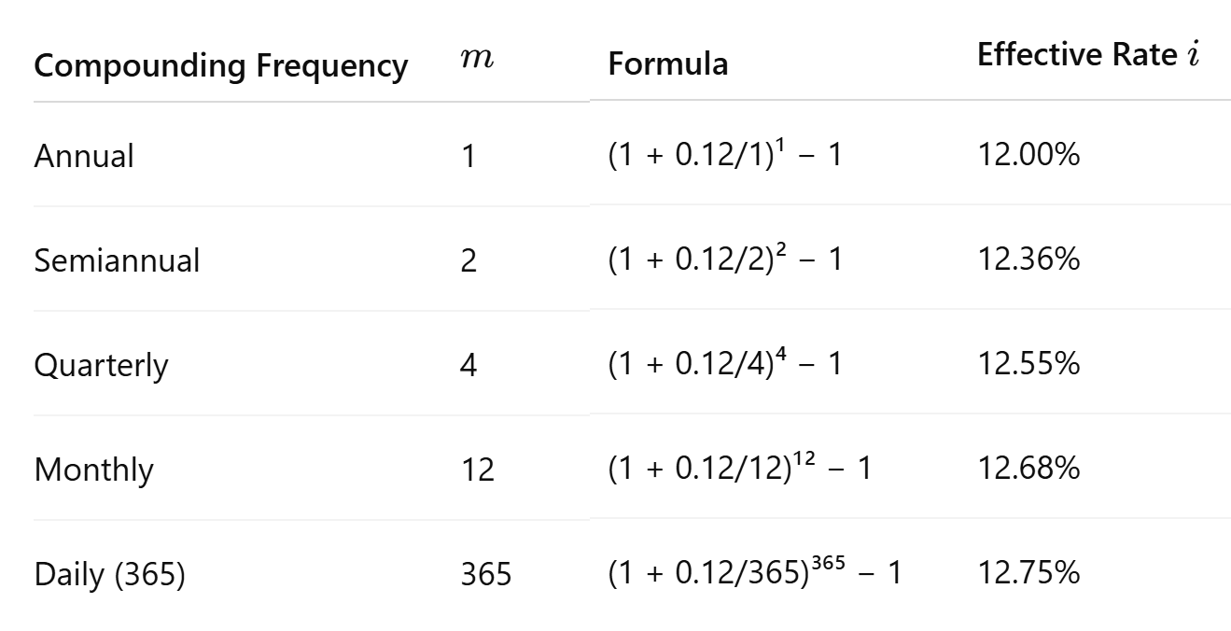
Comparison of Compounding Frequencies

Slide 45
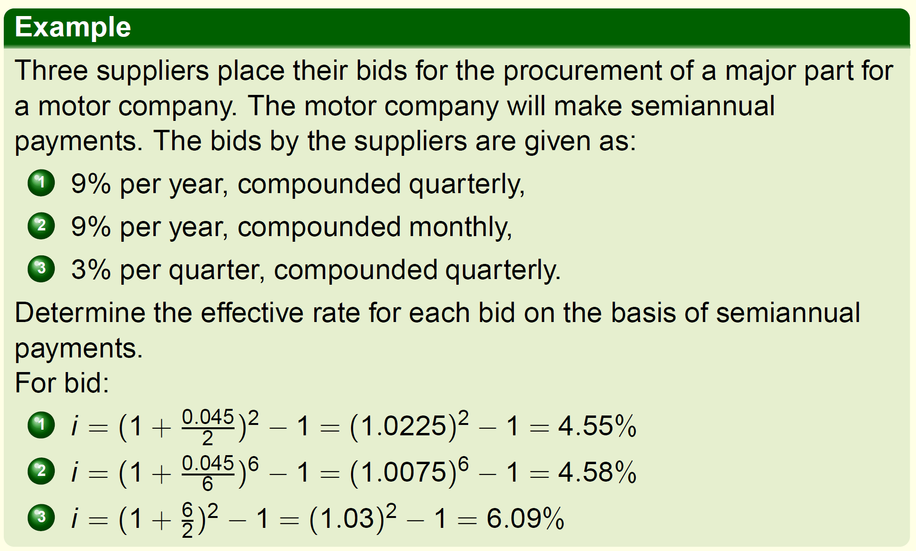

Slide 46
EXAMPLE
Three suppliers place their bids for the procurement of a major part for a motor company. The motor company will make semiannual (every 6 months) payments. The bids by the suppliers are given as:
9% per year, compounded quarterly,
9% per year, compounded monthly,
3% per quarter, compounded quarterly.
Determine the effective rate for each bid on the basis of semiannual payments.

Slide 47
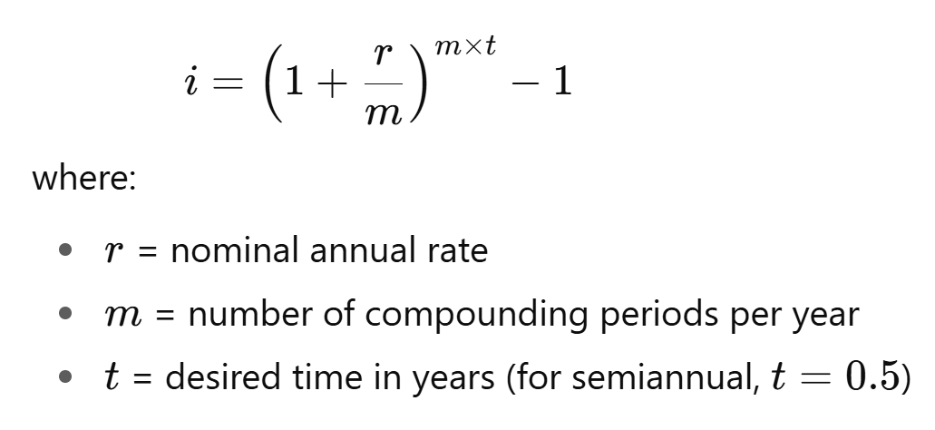

Slide 48
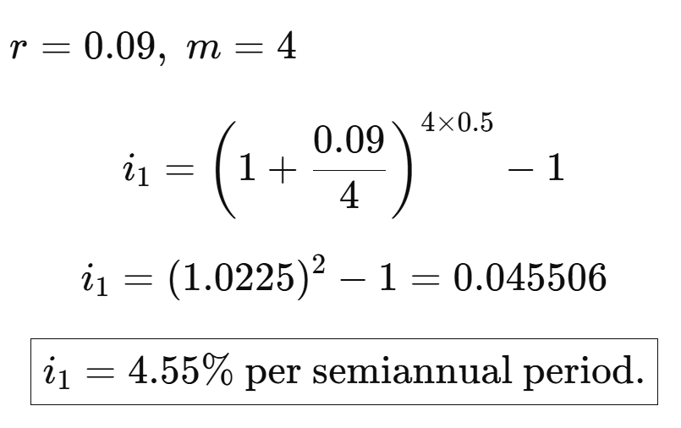
9% per year, compounded quarterly

Slide 49
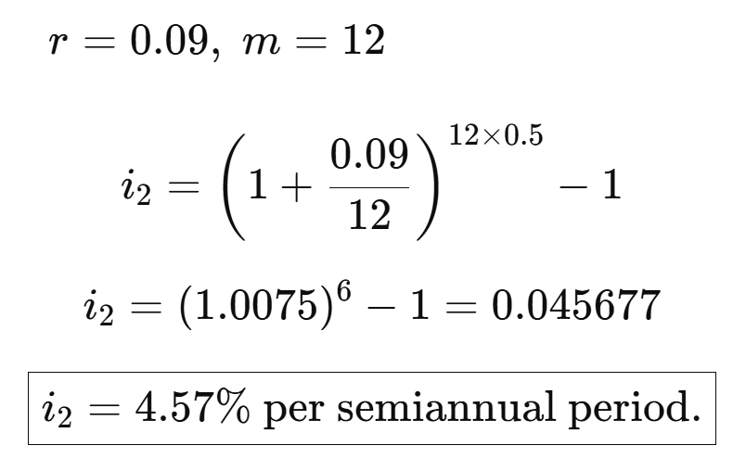
9% per year, compounded monthly

Slide 50
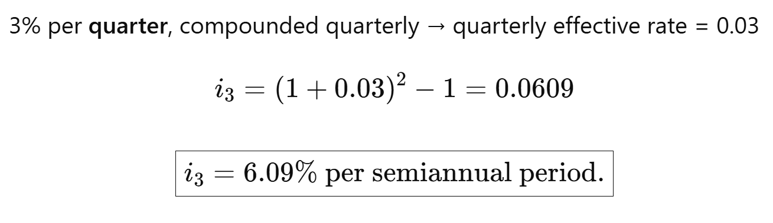
3% per quarter, compounded quarterly

Slide 51
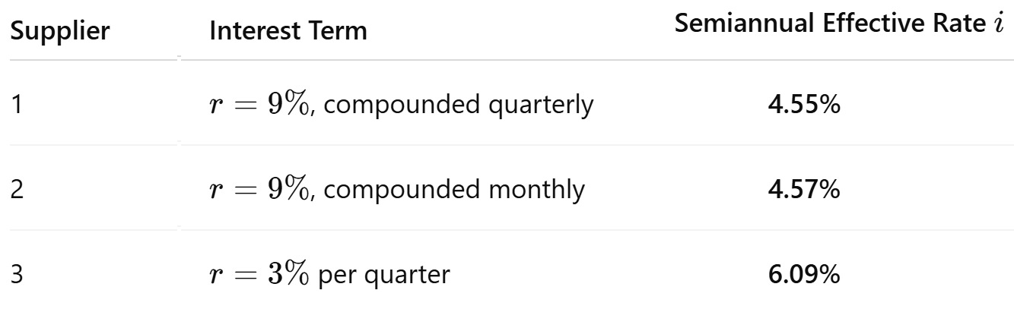
Therefore, Supplier 1 provides the most favorable financing terms for the motor company.

Slide 52
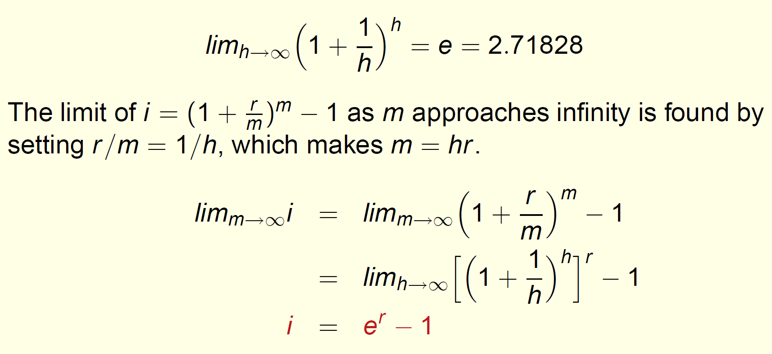
Allowing more and more frequent compounding, increases the number of compounding periods per time period, m. As m approaches infinity, the effective interest rate must be written in a new form.
Therefore, Supplier 1 provides the most favorable financing terms for the motor company.
This formula compute the effective continuous interest rate when the time periods on i and r are the same.

Slide 53
